Slide 1

Exam Stress Detection in University Students: Using Activity Data and Machine Learning Techniques
North Western University
Presentation on
Group Members
Name | Student ID
Sneara Parvin | 20201074010
Baig Azizul Hakim | 20201078010
Afia Farzana Maliha | 20201109010
Umma Habiba Tuly | 20201124010
Section C
Department Of Computer Science And Engineering
North Western University, Khulna, Bangladesh.
06 May, 2024

Slide 2
Overview
Background
Objectives
Methodology
Evaluation and Result
Conclusion
References
Page 2
06 May, 2024

Slide 3
Background
Introduction (continue)
Stress affects both the mind and the body. A little bit of stress is good and can help us perform daily activities. Too much stress can cause physical and mental health problems [1].
Exam stress is the feeling of tension and worry that comes from test-taking situations. It is normal to feel some stress about upcoming tests, exams, papers or presentations. Indeed, a small amount of stress can challenge you and stimulate you to work harder [2].
An estimated 25% people suffer from mental health disorders worldwide. Almost 7 million suffer from anxiety and depression in Bangladesh.
Page 3
06 May, 2024

Slide 4
Background (continue)
Introduction (continue)
Almost 7 million people in Bangladesh experience depressive and anxiety disorders respectively [3].
In Bangladesh, the levels of depression, anxiety, and stress has been reported to be as high as 54.3%, 64.8%, and 59.0%, respectively [4].
A prevalence rate of 10–35% of university students experience “functionally impairing levels of test anxiety [5].
The stress of examinations and mental health of students are correlated [6].
Page 4
06 May, 2024

Slide 5
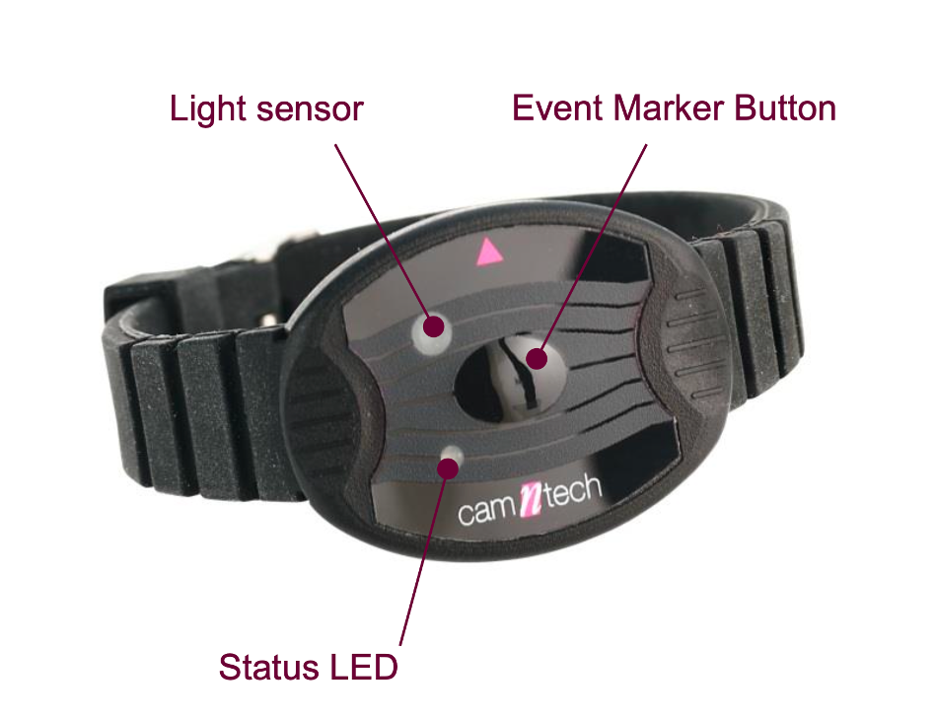
Background (continue)
Motion Watch
Features:
Wearable device
Tracks & analyze human activity and movement data
Clinically approved
Applications:
Studies physical activity
Track sleep patterns
Analyze circadian rhythms
Page 5
06 May, 2024

Slide 6
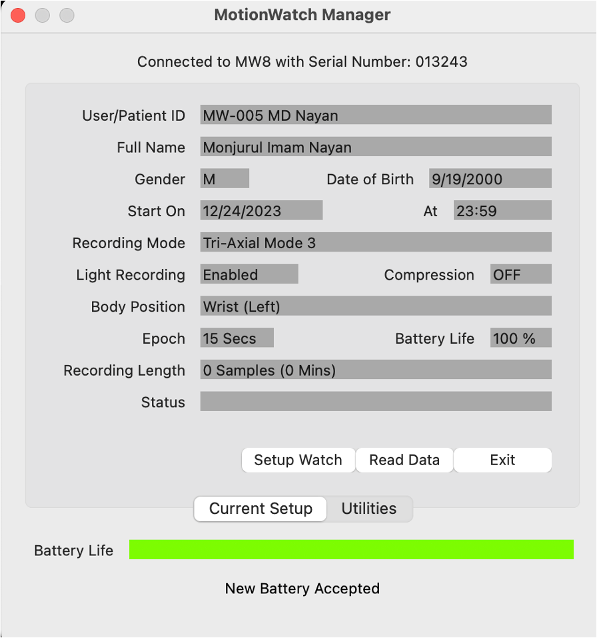
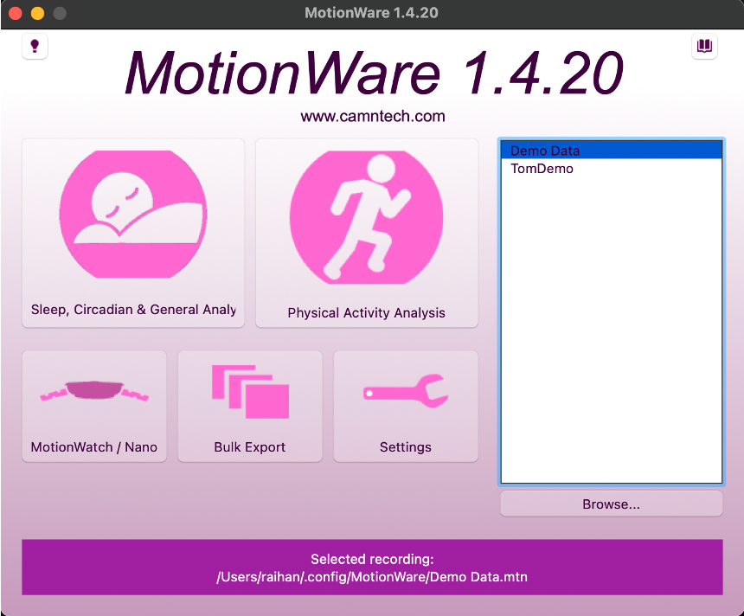
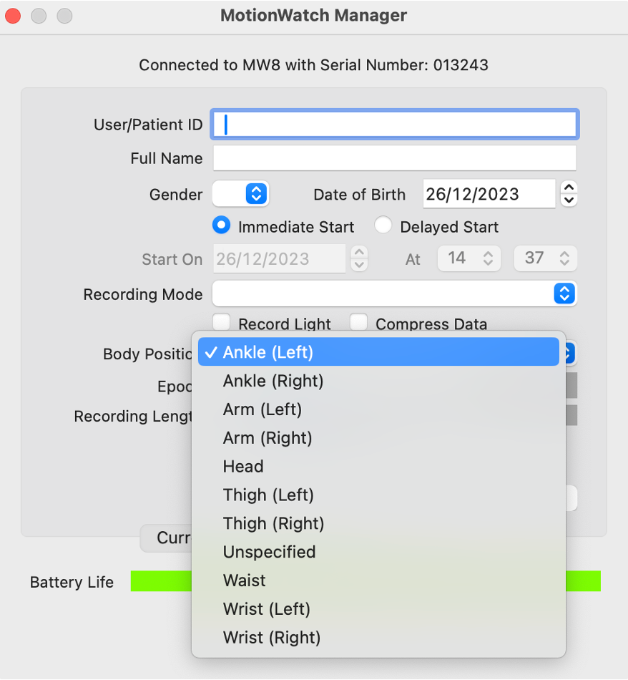
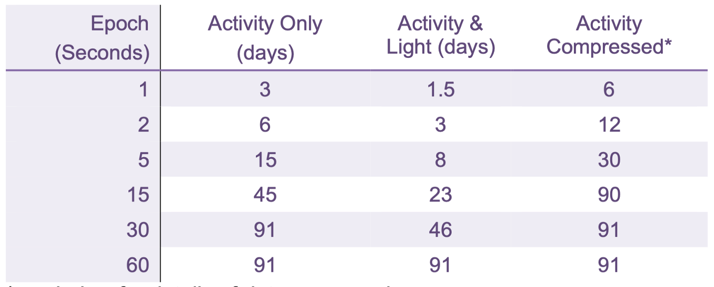
Background (continue)
Page 6
06 May, 2024

Slide 7
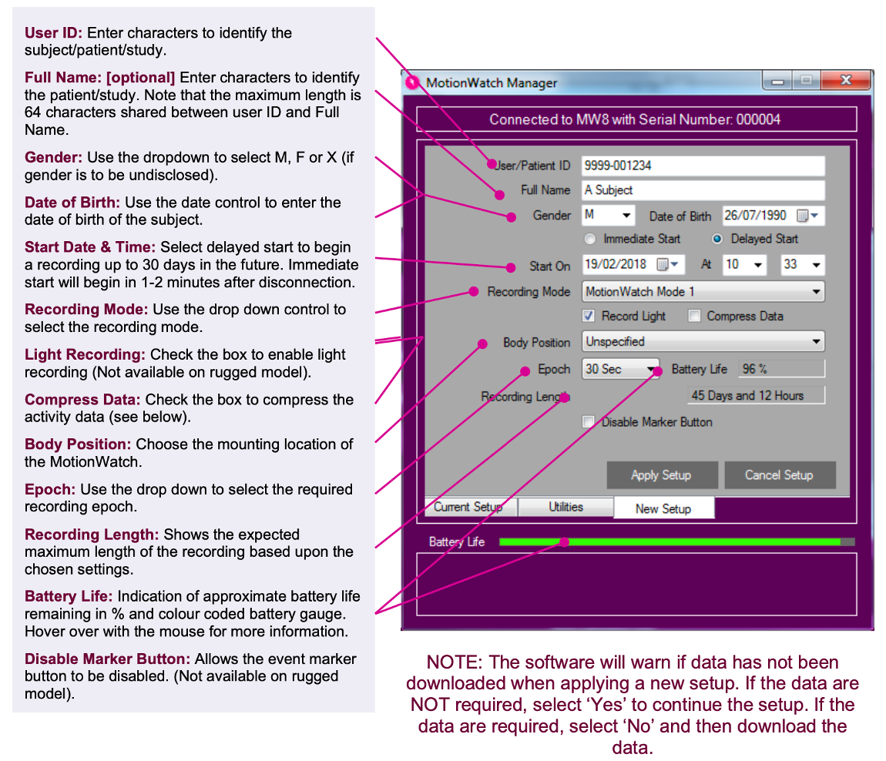
Background (continue)
Motion watch initial setup
guide
Page 7
06 May, 2024

Slide 8
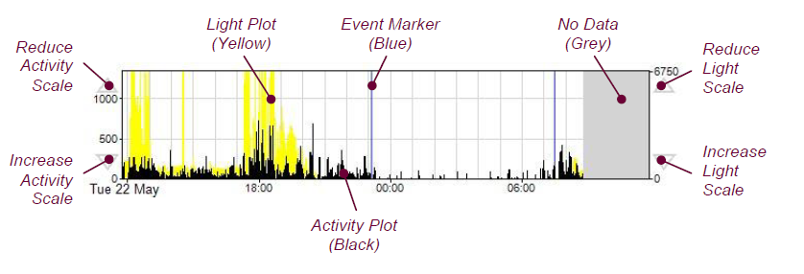
Background (continue)
Figure: Detailed View of Graph
Page 8
06 May, 2024

Slide 9
Objective
Investigate the Prevalence and Nature of Exam Stress.
Examine the Impact of Exam Stress on Academic Performance and Well-being.
To collect and evaluate activity data.
Assess the Role of Educational Policies and Practices.
Page 9
06 May, 2024

Slide 10
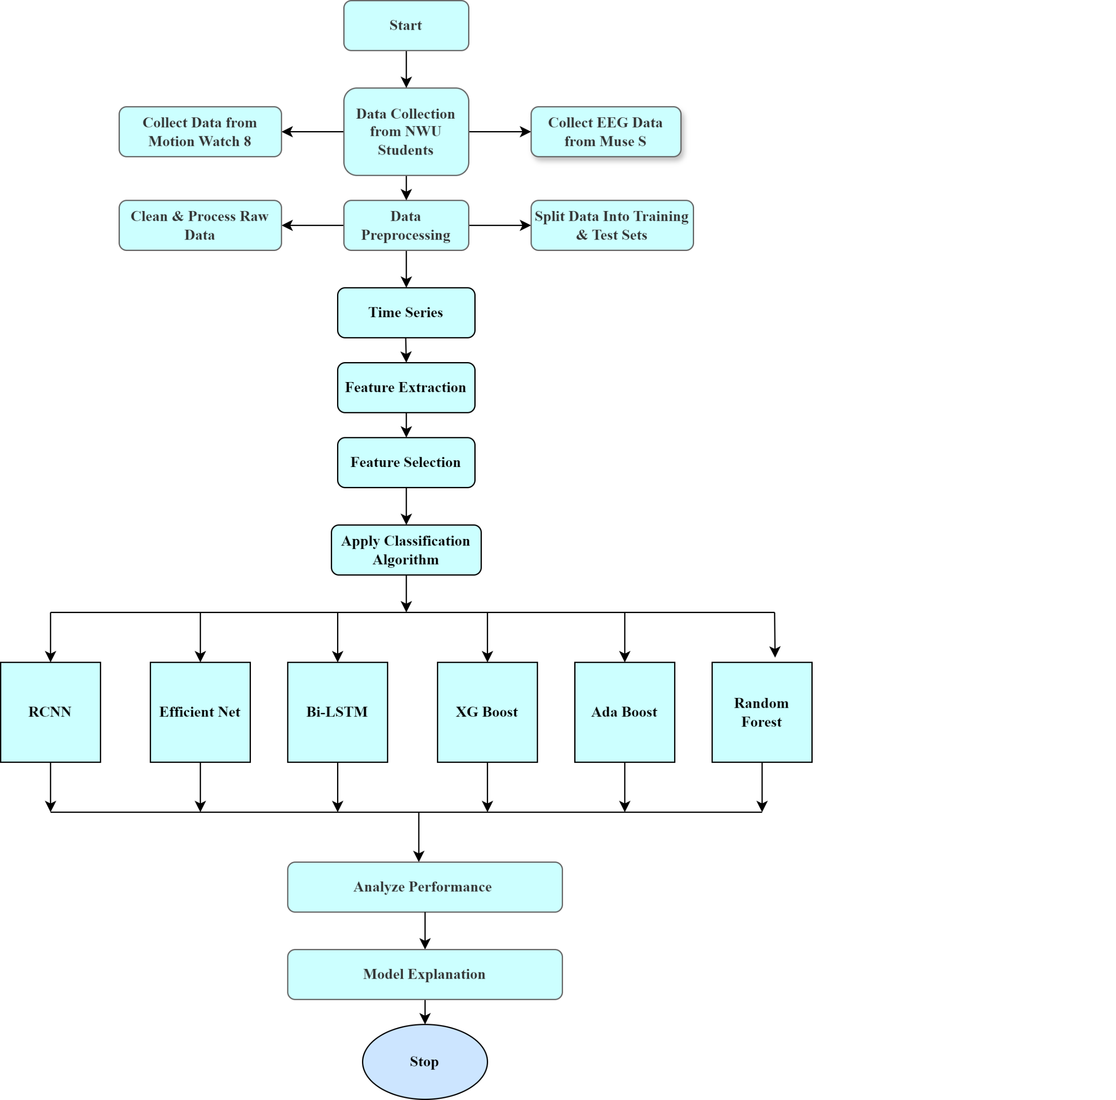
Methodology
Page 10
06 May, 2024
Figure : Workflow diagram of our analysis

Slide 11
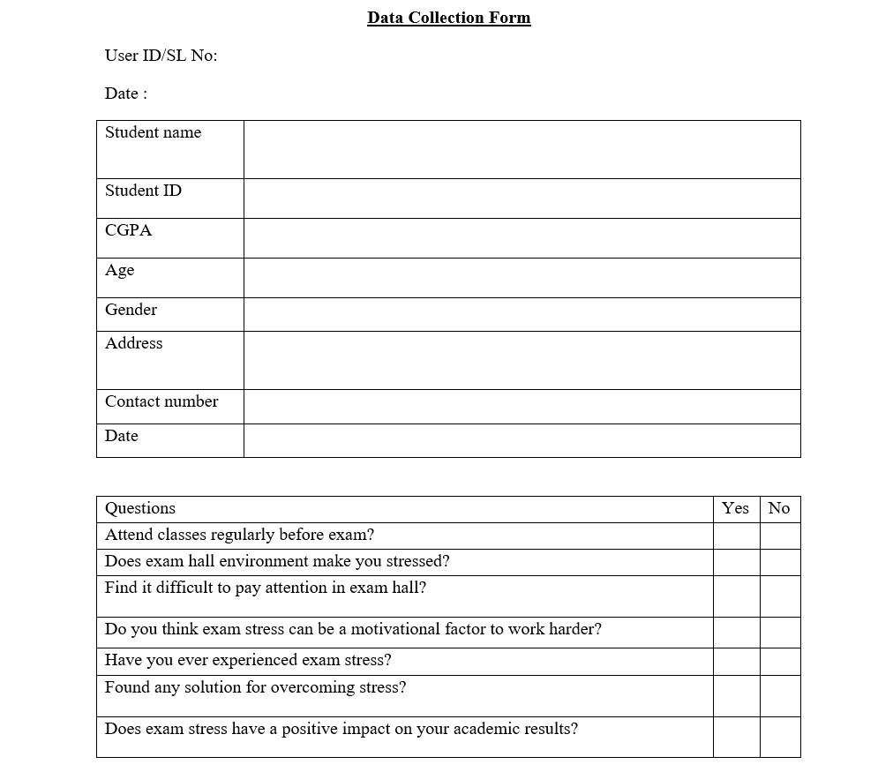
Methodology (Cont.)
20 Sample size
17 features
Page 11
06 May, 2024

Slide 12
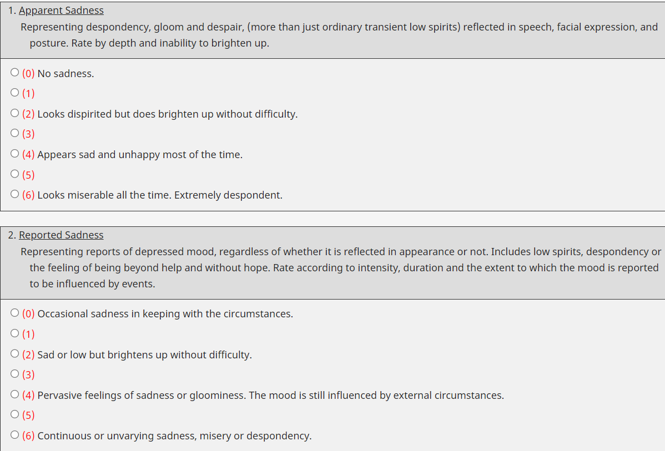
Methodology (Cont.)
(Montgomery–Asberg Depression Rating Scale)
MADRS Rating
Page 12
06 May, 2024

Slide 13
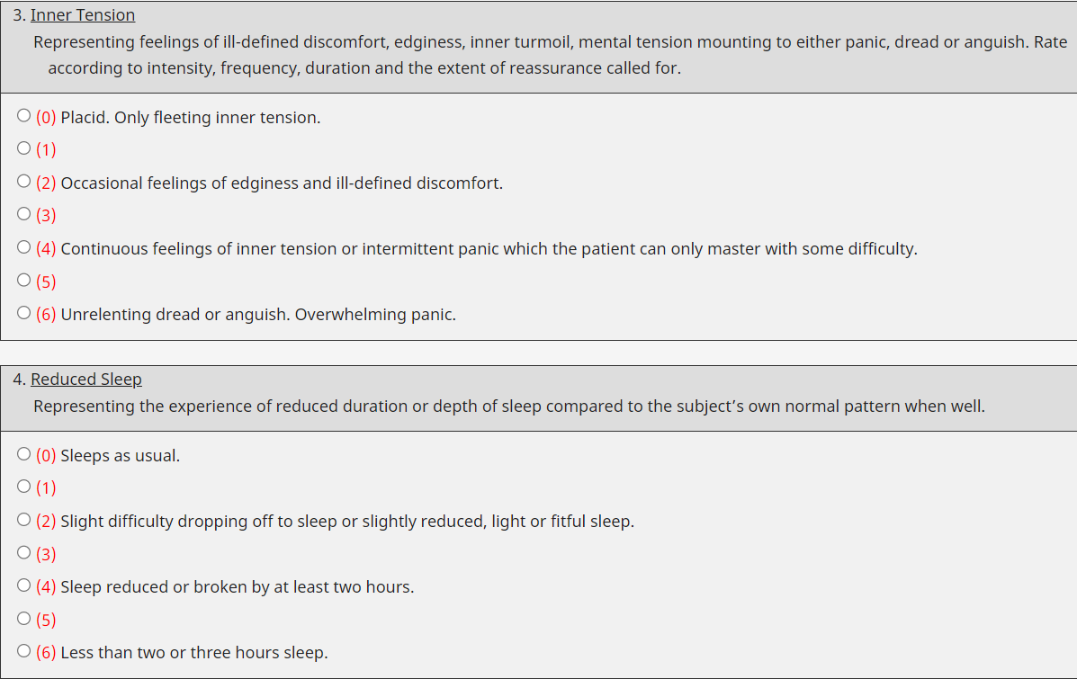
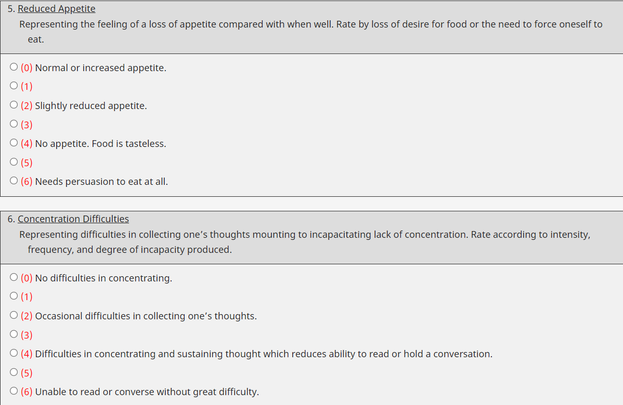
Methodology (Cont.)
Page13
06 May, 2024

Slide 14
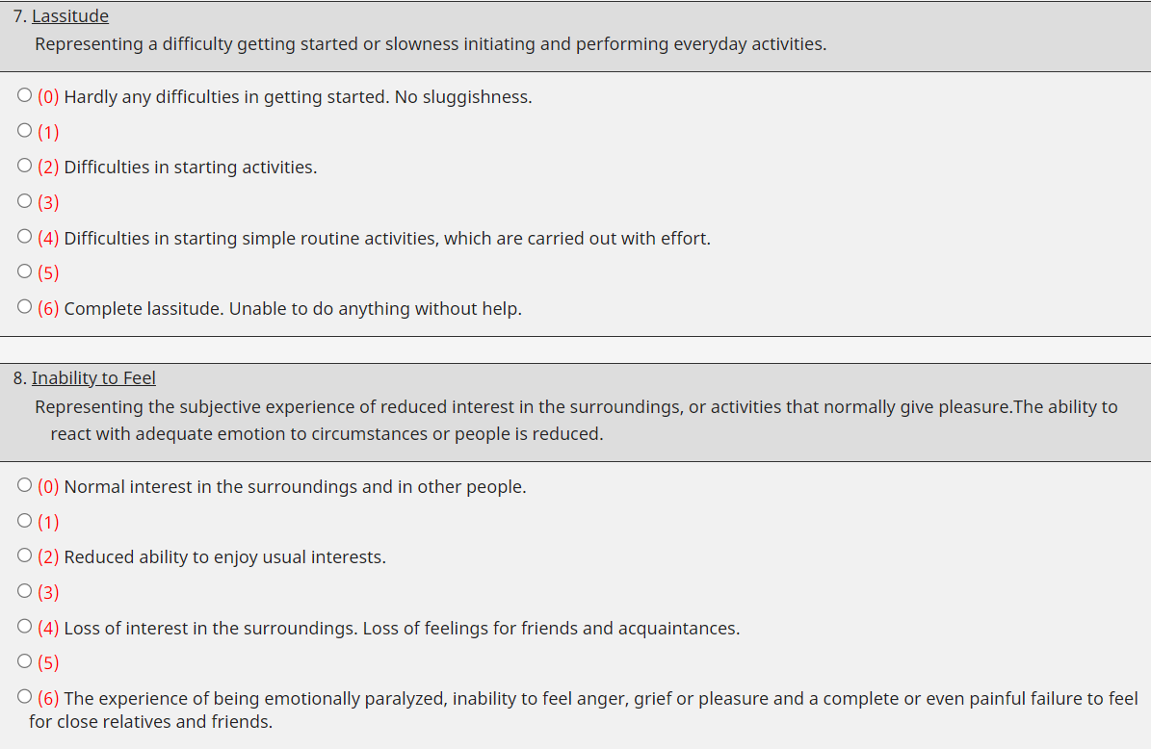
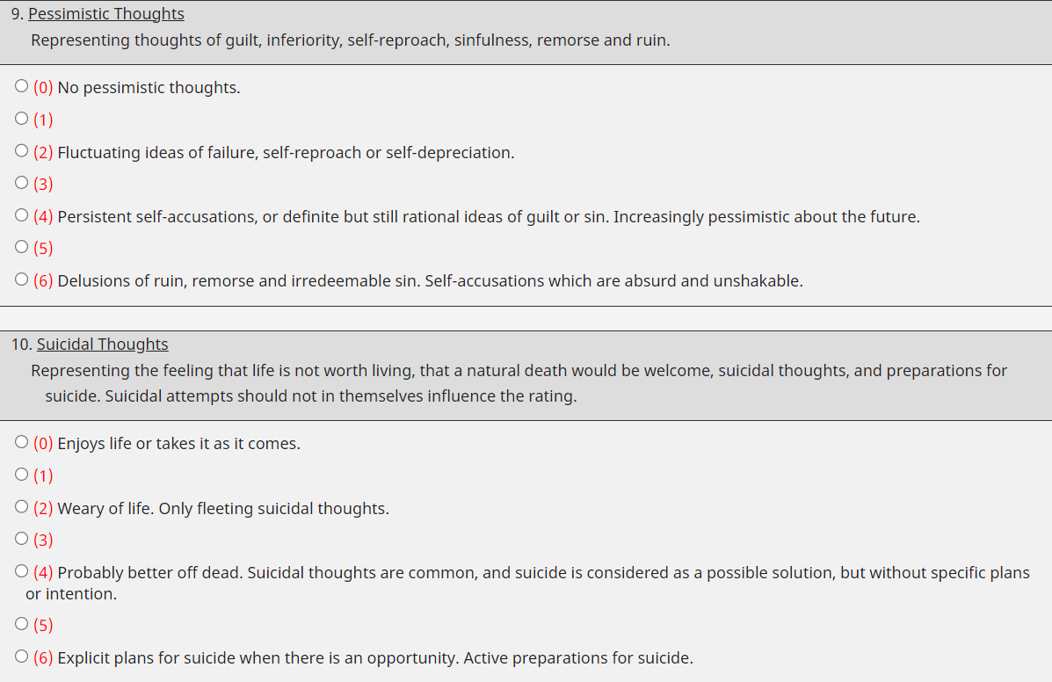
Methodology (Cont.)
Page 14
06 May, 2024

Slide 15

Methodology (Cont.)
0-6 normal depression
7-9 mild depression
20-34 moderate depression
35-60 severe depression
[7]
Page 15
06 May, 2024

Slide 16
Methodology (Cont.)
Extracted Features from Activity:
Mean (𝜇)
Kurtosis
Median
Standard deviation (sd, σ)
Skewness
Coefficient of variance
Variance
Minimum
Maximum
Autocorrelation
Root Mean Square
Zero-crossing rate
Number of peaks
Energy of the signal
W Bi mean
Interquartile range
Band power
Page 16
06 May, 2024

Slide 17
Methodology (Cont.)
Classification Algorithms :
RCNN
XG Boost
Ada Boost
Random Forest
Efficient Net
LSTM
Page 17
06 May, 2024

Slide 18
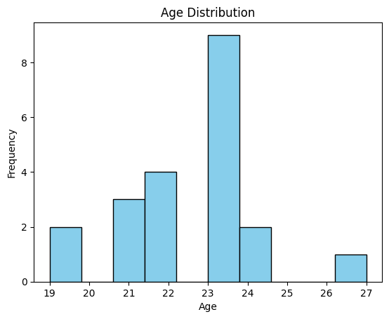
Evaluation and Results
Figure :Age Distribution
Page 18
06 May, 2024

Slide 19
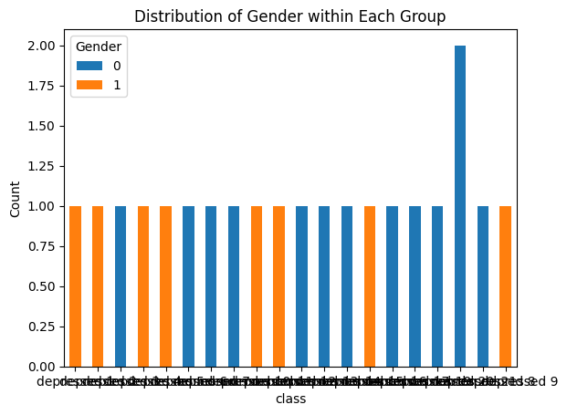
Evaluation and Results
0 defines Female
1 defines Male
Figure: Gender Distribution of Each Class
Page 19
06 May, 2024

Slide 20
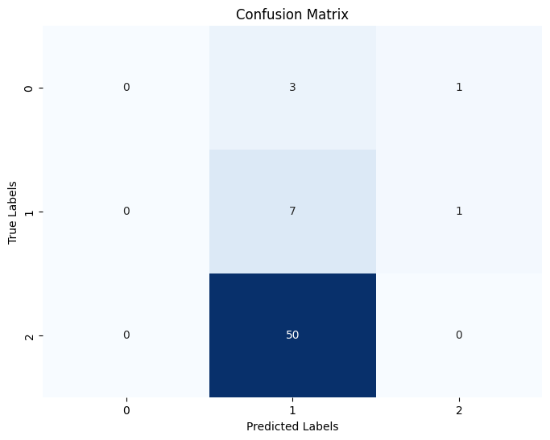
Evaluation and Results
Page 20
Figure : RCNN Confusion Matrix
06 May, 2024

Slide 21
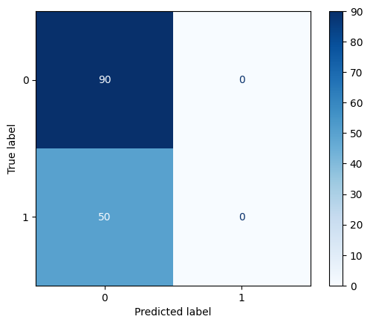
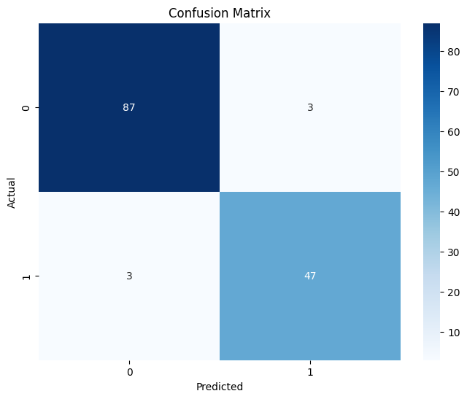
Evaluation and Results
Apply Classification Algorithm:
Figure: LSTM confusion matrix
Figure: Randomforest confusion matrix
Page 21
06 May, 2024

Slide 22
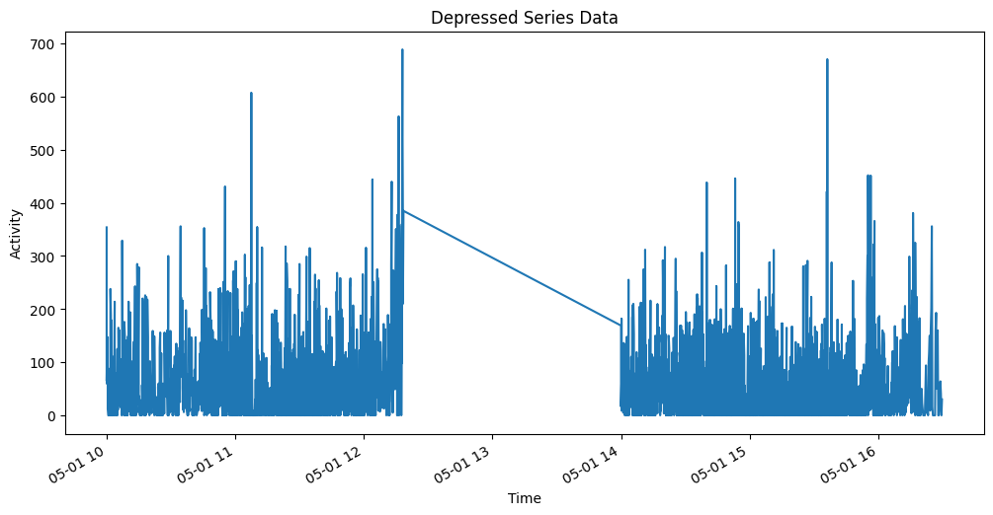
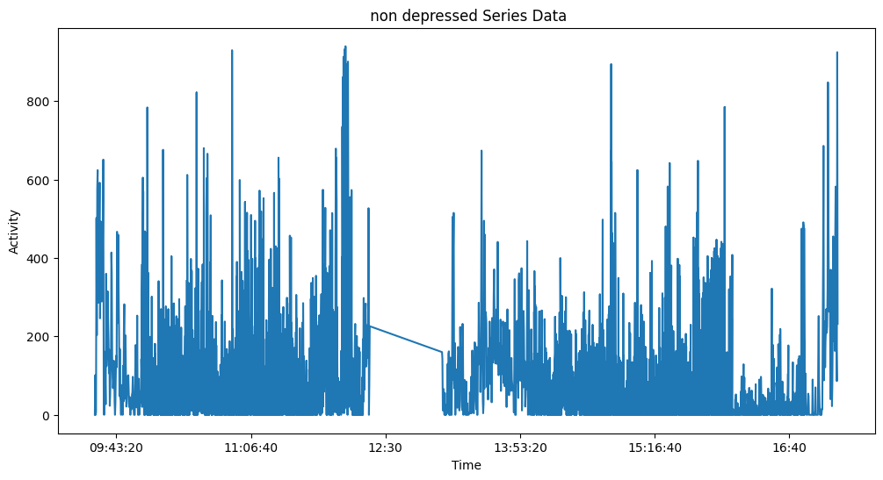
Evaluation and Results
Figure: Depressed & Non Depressed series data
Page 22
06 May, 2024

Slide 23
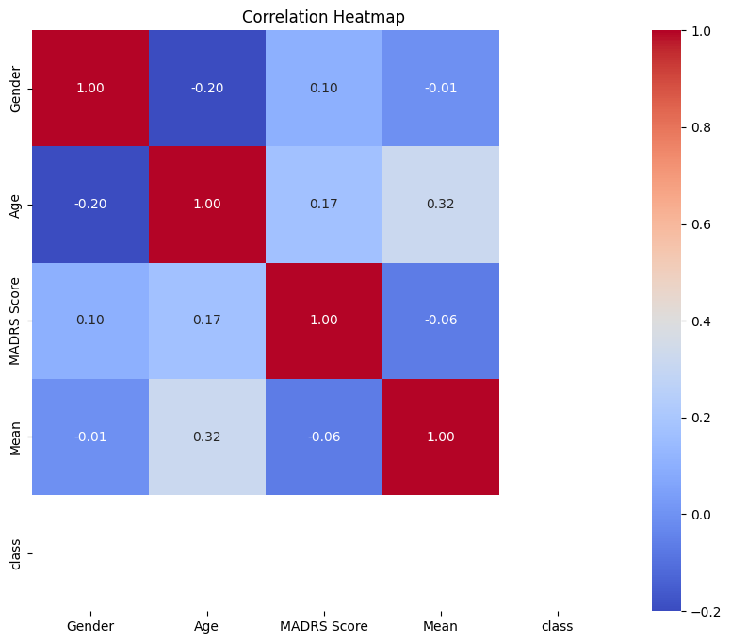
Evaluation and Results
Page 23
Figure: Correlation Heatmap
06 May, 2024

Slide 24
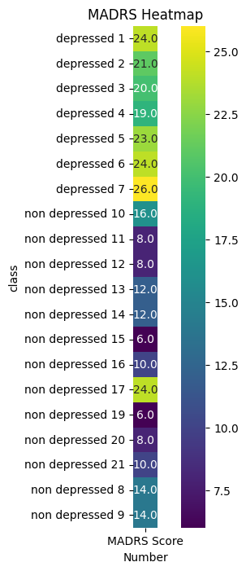
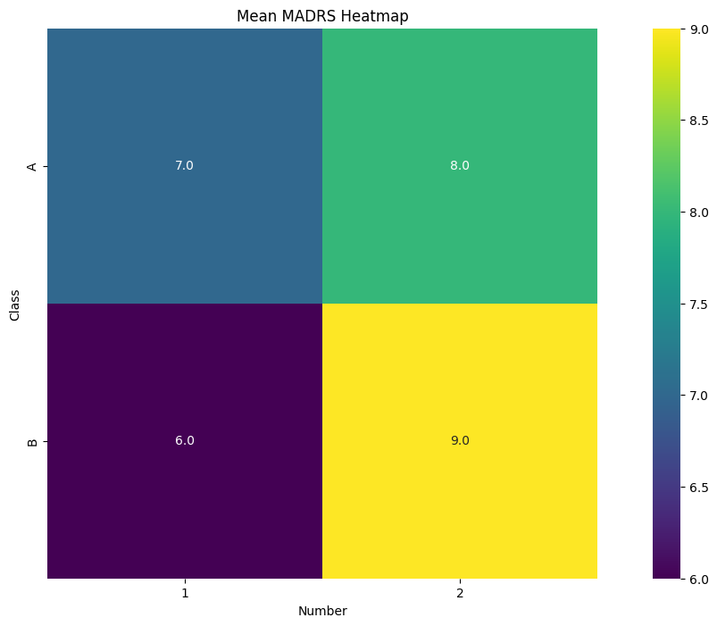
Evaluation and Results
Page 24
Figure: MADRS & Mean MADRS Heat Map
06 May, 2024

Slide 25
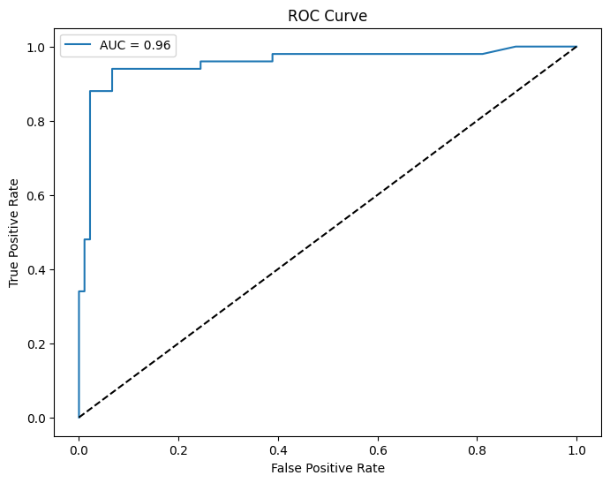
Evaluation and Results
Accuracy : 0.96
Figure : Random forest false positive rate
Page 25
06 May, 2024

Slide 26
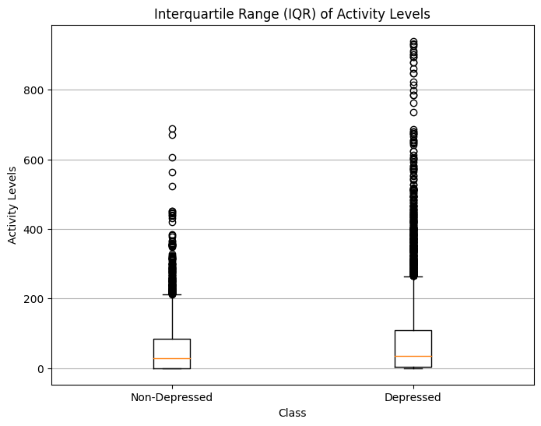
Evaluation and Results
Figure : Interquartile Range of activity levels
Page 26
06 May, 2024

Slide 27
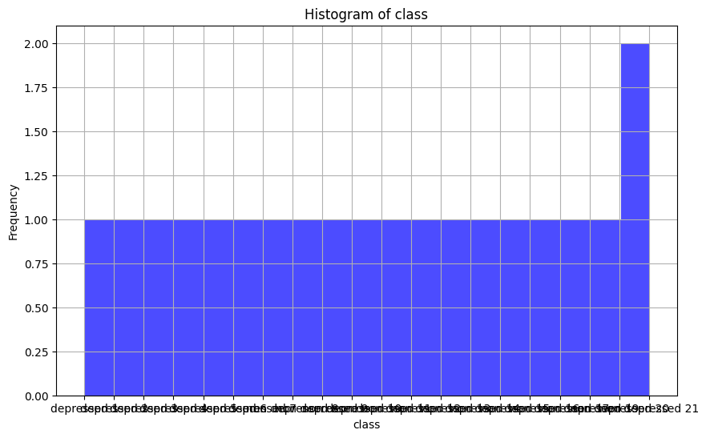
Evaluation and Results
Figure : Histogram of class
Page 27
06 May, 2024

Slide 28
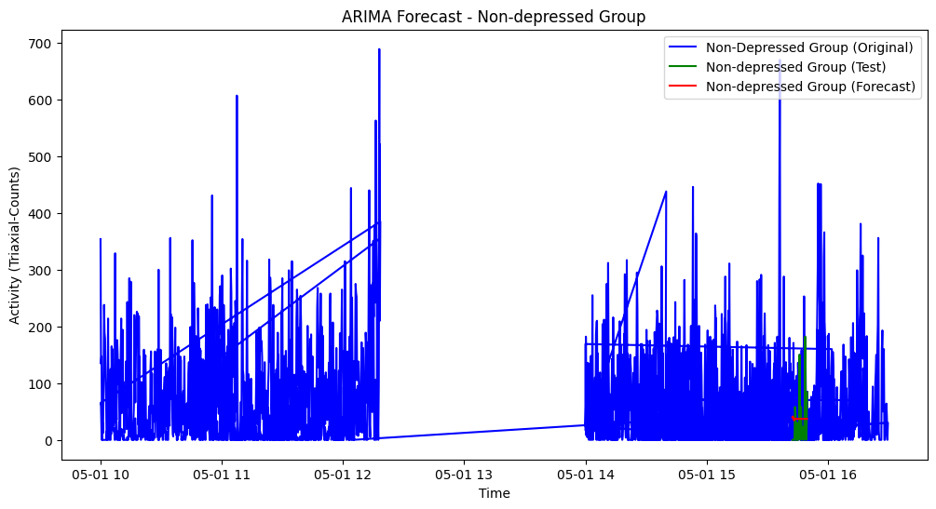
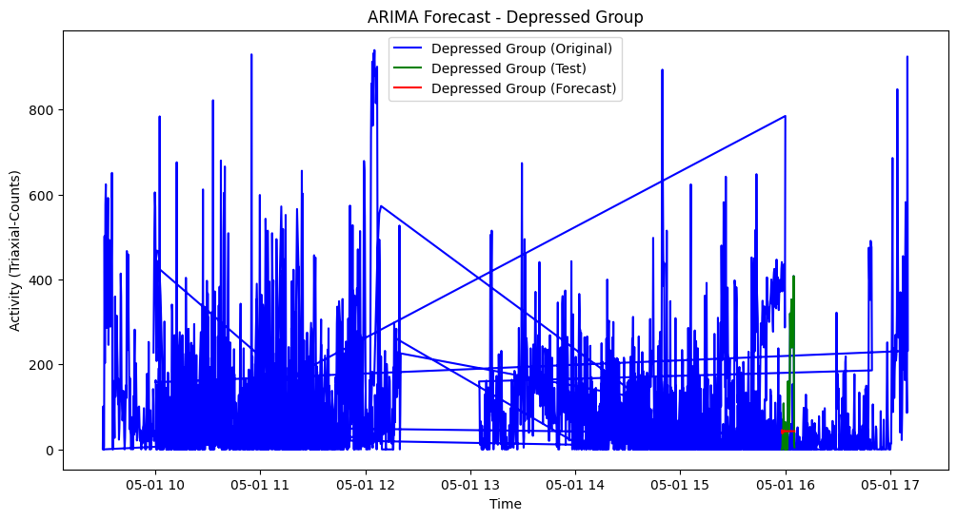
Evaluation and Results
Figure : Arima Forecast of Depressed & Non Depressed group
Page 28
06 May, 2024

Slide 29
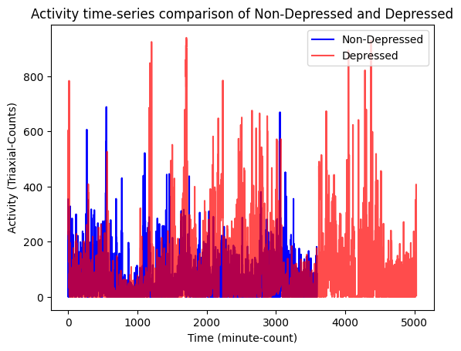
Evaluation and Results
Figure : Time Series Activity Comparison
Page 29
06 May, 2024

Slide 30
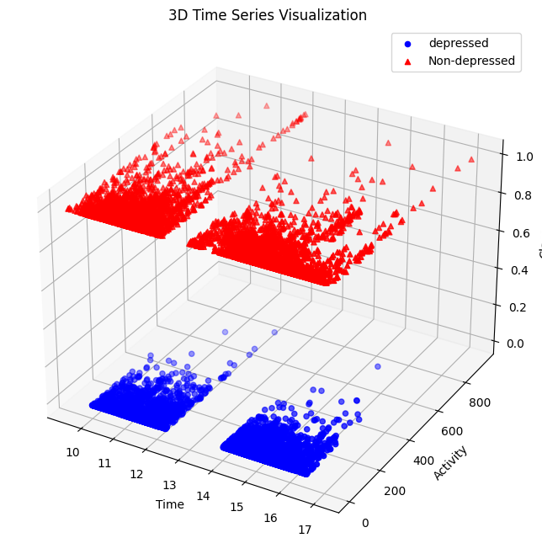
Evaluation and Results
Figure : 3D Time Series visualization
Page 30
06 May, 2024

Slide 31
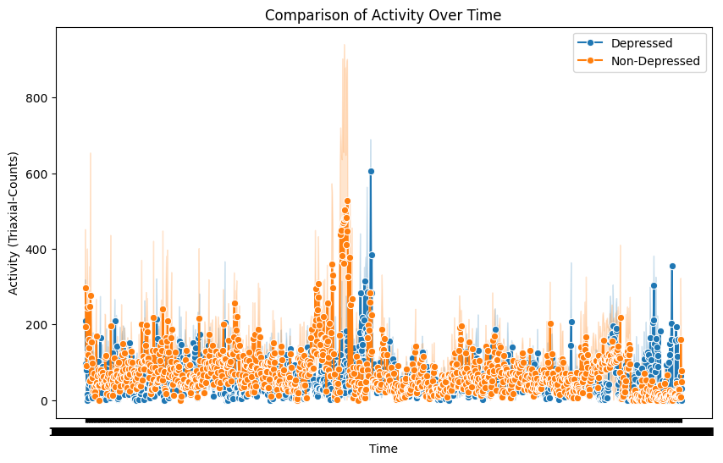
Evaluation and Results
Figure : Comparison of Activity Over Time
Page 31
06 May, 2024

Slide 32
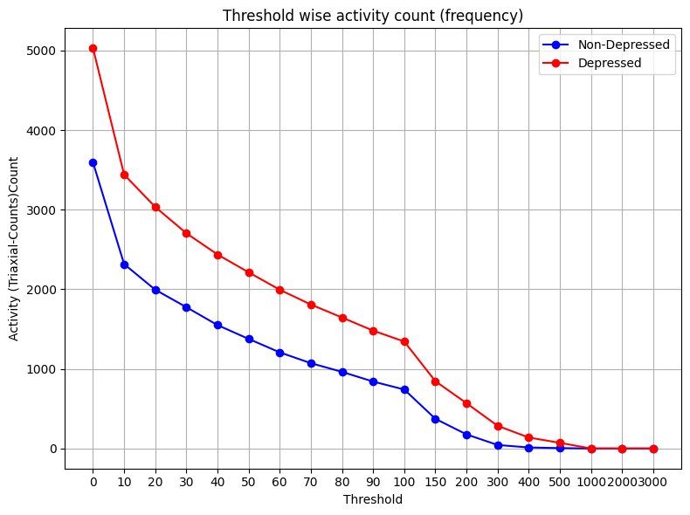
Evaluation and Results
Page 32
Figure : Threshold wise tri-axial activity count
06 May, 2024

Slide 33
Conclusion
Metric | R-CNN | AdaBoost | XG Boost | Efficient Net | LSTM | Random Forest
Accuracy | 0.46 | 0.91 | 0.98 | 0.55 | 0.64 | 0.95
precession | 0.49 | 0.93 | 0.98 | 0.64 | 0.32 | 0.95
Recall | 0.52 | 0.93 | 0.98 | 0.55 | 0.5 | 0.95
F1 Score | 0.50 | 0.93 | 0.98 | 0.50 | 0.38 | 0.91
Kappa | 0.61 | 0.81 | 0.81 | 0.90 | 0.0 | 0.90
Page 33
06 May, 2024

Slide 34
References
[1] How does stress affect us? [online] Available: https://www.who.int//news-room/questions-and-answers/item/stress/?gad_source=1&gclid=Cj0KCQjwltKxBhDMARIsAG8KnqUIkbj4lEGxQVbFjZkDpvY2O0FDN8E24_87SDnpyVsTTyxyXMkxOEEaAmTFEALw_wcB
[2] Exam stress, [online] Available: https://www.concordia.ca/cunews/offices/provost/health/topics/stress-management/exam-stress.html#:~:text=Exam%20stress%20is%20the%20feeling,stimulate%20you%20to%20work%20harder.
[3] World Health Organization (2020b) Mental Health: Current mental health situation in Bangladesh. Available at: http://www.searo.who.int/bangladesh/mental-health/en/
[4] Mental disorders in Bangladesh: a systematic review, Mohammad Didar Hossain1 , Helal Uddin Ahmed2 , Waziul Alam Chowdhury2† , Louis Wilhelmus Niessen3,4† and Dewan Shamsul Alam1* Available at: https://pubmed.ncbi.nlm.nih.gov/25073970/
[5] Chapell M.S. Test anxiety and academic performance in undergraduate and graduate students. Journal of Educational Psychology. 2005;97(2):268–274. doi: 10.1037/0022-0663.97.2.268.
[6] Bayram N., Bilgel N. The prevalence and socio-demographic correlations of depression, anxiety and stress among a group of university students. Social Psychiatry and Psychiatric Epidemiology. 2008;43(8):667–672. doi: 10.1007/s00127-008-0345-x.
[7] https://en.wikipedia.org/wiki/Montgomery%E2%80%93%C3%85sberg_Depression_Rating_Scale
Page 34
06 May, 2024

